Slide 1
VMware vFabric – Gemfire

Slide 2
What is vFabric SQLFire?
SQLFire is a memory-optimized distributed SQL database.
SQLFire attacks scalability challenges in two ways:
Relaxes ACID semantics somewhat (in transactions and in replication)
Horizontally scalable. Add capacity by adding nodes.
SQLFire has built-in high availability and native support for replication to multiple datacenters.
SQLFire provides a real SQL interface. Ships with JDBC and ADO.NET bindings with more to come.
SQLFire can also be used as a cache in front of other databases.

Slide 3
SQLFire at-a-glance
3

Slide 4

The database world is changing.
Many new data models (NoSQL) are emerging
Key-value
Column family (inspired by Google BigTable)
Document
Graph
Most focus on making model less rigid than SQL
Consistency model is not ACID
Different tradeoffs for different goals
Low scale
High scale
Very high scale
STRICT – Full ACID (RDB)
Tunable Consistency
Eventual

Slide 5
SQLFire Versus NoSQL
Attribute | NoSQL | SQLFire
DB Interface | Idiosyncratic (i.e. each is custom). | Standard SQL.
Querying | Idiosyncratic or not present. | SQL Queries.
Data Consistency | Tunable, most favor eventual consistency. | Tunable, favors high consistency.
Transactions | Weak or not present. | Linearly scalable transaction model.
Interface Design | Designed for simplicity. | Designed for compatibility.
Data Model | Wide variety of different models. | Relational model.
Schema Flexibility | Focus on extreme flexibility, dynamism. | SQL model, requires DB migrations, etc.

Slide 6
SQLFire Versus Other SQL Databases
Attribute | SQLFire | Other SQL DBs
DB Interface | Standard SQL. | Standard SQL.
Data Consistency | Tunable. Mix of eventual consistency and high consistency. | High consistency.
Transactions | Supported. | Very strong support.
Scaling Model | Scale out, commodity servers. | Scale up.

Slide 7
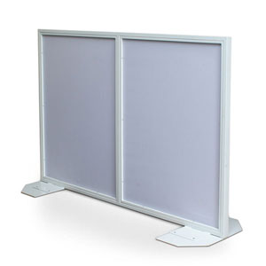
Scaling SQLFire
Partitioning & Replication

Slide 8
How SQLFire scales a common DB schema.
Assume, thousands of flight rows, millions of flightavailability records

Slide 9

Creating Tables
CREATE TABLE AIRLINES (
AIRLINE CHAR(2) NOT NULL PRIMARY KEY,
AIRLINE_FULL VARCHAR(24),
BASIC_RATE DOUBLE PRECISION,
DISTANCE_DISCOUNT DOUBLE PRECISION,…. );
Table
SQLF
SQLF
SQLF

Slide 10
Replicated Tables
CREATE TABLE AIRLINES (
AIRLINE CHAR(2) NOT NULL PRIMARY KEY,
AIRLINE_FULL VARCHAR(24),
BASIC_RATE DOUBLE PRECISION,
DISTANCE_DISCOUNT DOUBLE PRECISION,…. )
REPLICATE;
Replicated Table
Replicated Table
Replicated Table
SQLF
SQLF
SQLF

Slide 11
Partitioned Tables
CREATE TABLE FLIGHTS (
FLIGHT_ID CHAR(6) NOT NULL ,
SEGMENT_NUMBER INTEGER NOT NULL ,
ORIG_AIRPORT CHAR(3),
DEST_AIRPORT CHAR(3)
DEPART_TIME TIME,
FLIGHT_MILES INTEGER NOT NULL)
PARTITION BY COLUMN(FLIGHT_ID);
Replicated Table
Table
Replicated Table
Replicated Table
Partitioned Table
Partitioned Table
Partitioned Table
SQLF
SQLF
SQLF

Slide 12
Partition Redundancy
CREATE TABLE FLIGHTS (
FLIGHT_ID CHAR(6) NOT NULL ,
SEGMENT_NUMBER INTEGER NOT NULL ,
ORIG_AIRPORT CHAR(3),
DEST_AIRPORT CHAR(3)
DEPART_TIME TIME,
FLIGHT_MILES INTEGER NOT NULL)
PARTITION BY COLUMN (FLIGHT_ID) REDUNDANCY 1;
Replicated Table
Table
Replicated Table
Replicated Table
Partitioned Table
Partitioned Table
Partitioned Table
Redundant Partition
Redundant Partition
Redundant Partition
SQLF
SQLF
SQLF

Slide 13
Partition Colocation
CREATE TABLE FLIGHTAVAILABILITY (
FLIGHT_ID CHAR(6) NOT NULL ,
SEGMENT_NUMBER INTEGER NOT NULL ,
FLIGHT_DATE DATE NOT NULL ,
ECONOMY_SEATS_TAKEN INTEGER DEFAULT 0, …)
PARTITION BY COLUMN (FLIGHT_ID)
COLOCATE WITH (FLIGHTS);
Replicated Table
Table
Replicated Table
Replicated Table
Partitioned Table
Partitioned Table
Partitioned Table
Colocated Partition
Colocated Partition
Colocated Partition
Redundant Partition
Redundant Partition
Redundant Partition
SQLF
SQLF
SQLF

Slide 14
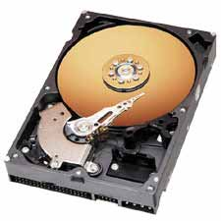
Persistent Tables
CREATE TABLE FLIGHTAVAILABILITY (
FLIGHT_ID CHAR(6) NOT NULL ,
SEGMENT_NUMBER INTEGER NOT NULL ,
FLIGHT_DATE DATE NOT NULL ,
ECONOMY_SEATS_TAKEN INTEGER DEFAULT 0, …)
PARTITION BY COLUMN (FLIGHT_ID) COLOCATE WITH (FLIGHTS)
PERSISTENT persistentStore ASYNCHRONOUS;
Data dictionary is always persisted in each server
sqlf backup /export/fileServerDirectory/sqlfireBackupLocation
Replicated Table
Table
Replicated Table
Replicated Table
Partitioned Table
Partitioned Table
Partitioned Table
Colocated Partition
Colocated Partition
Colocated Partition
Redundant Partition
Redundant Partition
Redundant Partition
SQLF
SQLF
SQLF

Slide 15
Consistency model

Slide 16
Consistency Model without Transactions
Replication within cluster is always eager and synchronous
Row updates are always atomic; No need to use transactions
FIFO consistency: writes performed by a single thread are seen by all other processes in the order in which they were issued
Consistency in Partitioned tables
a partitioned table row owned by one member at a point in time
all updates are serialized to replicas through owner
"Total ordering" at a row level: atomic and isolated
Membership changes and consistency – need another hour ☺
Pessimistic concurrency support using ‘Select for update’
Support for referential integrity

Slide 17
SQLFire Transactions
Highly scalable without any centralized coordinator or lock manager
We make some important assumptions
Most OLTP transactions are small in duration and size
Write-write conflicts are very rare in practice
How does it work?
Each data node has a sub-coordinator to track TX state
Eagerly acquire local “write” locks on each replica
Object owned by a single primary at a point in time
Fail fast if lock cannot be obtained
Atomic and works with the cluster Failure detection system
Isolated until commit
Only support local isolation during commit

Slide 18
Scaling disk access with shared nothing disk files and a “journaling” store design

Slide 19
Disk persistence in SQLF
Parallel log structured storage
Each partition writes in parallel
Backups write to disk also
Increase reliability against h/w loss
Don’t seek to disk
Don’t flush all the way to disk
Use OS scheduler to time write
Do this on primary + secondary
Realize very high throughput

Slide 20
Performance benchmark

Slide 21
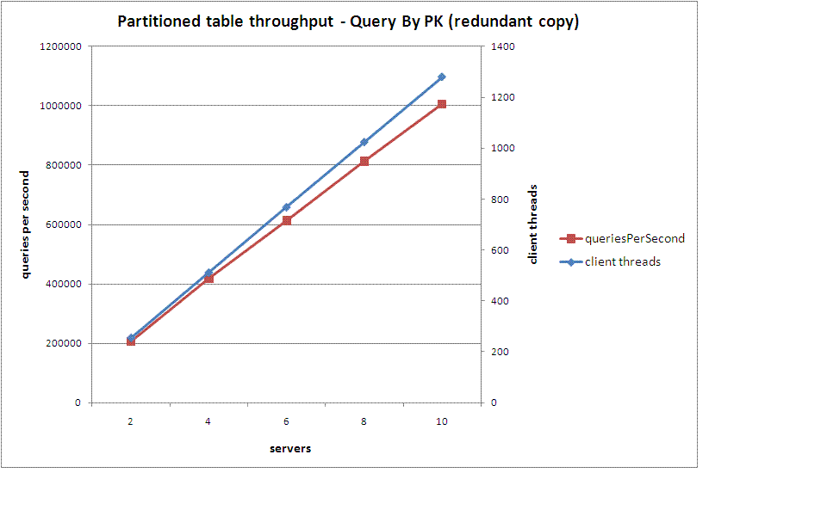
How does it perform? Scale?
Scale from 2 to 10 servers (one per host)
Scale from 200 to 1200 simulated clients (10 hosts)
Single partitioned table: int PK, 40 fields (20 ints, 20 strings)

Slide 22
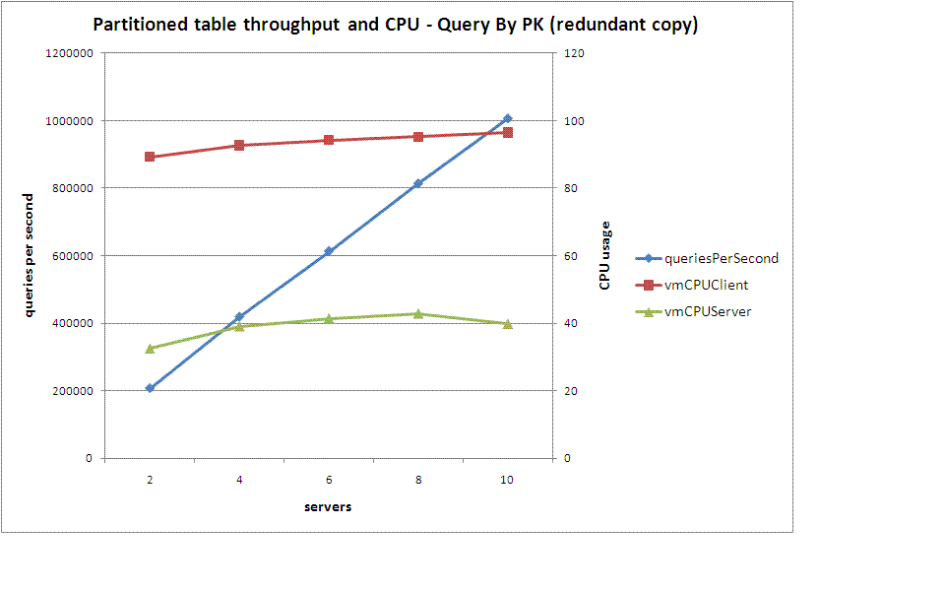
How does it perform? Scale?
CPU% remained low per server – about 30% indicating many more clients could be handled

Slide 23
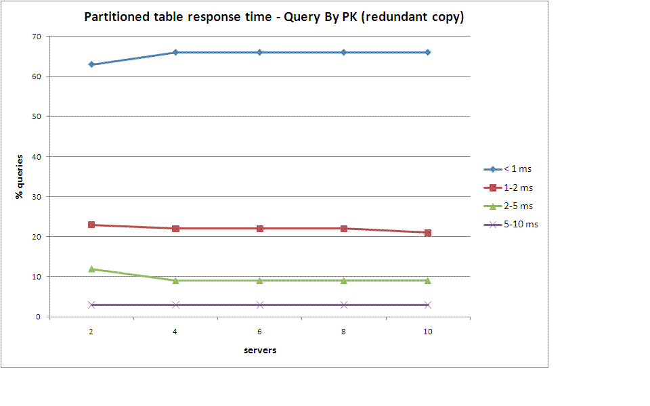
Is latency low with scale?
Latency decreases with server capacity
50-70% take < 1 millisecond
About 90% take less than 2 milliseconds

Slide 24
Sample App
24
Notes:
24

Slide 25
Questions and Answers
25
Notes:
25

